Slide 1
See, Think, Wonder - abbreviated
With each image that comes up we will share out:
What we actually SEE
What we THINK we see
What we WONDER about the images …
Keep this related to the topic of the day:
Moving West – why people moved?
Notes:
Draw chart next to ppt → for each thing they see/notice, how is this a reason to move west?

Slide 2
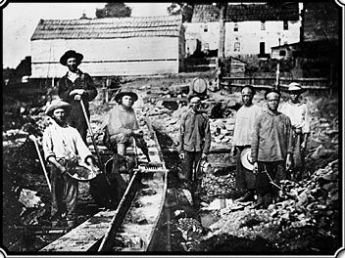
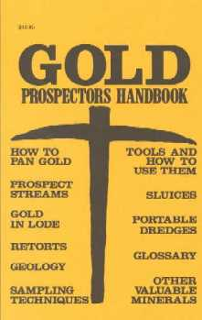

Slide 3
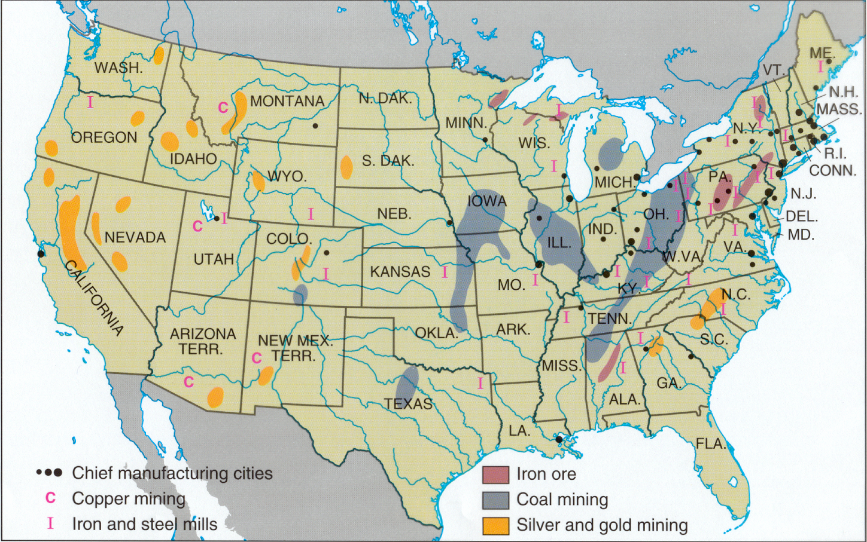
Notes:
Mining Centers 1900

Slide 4
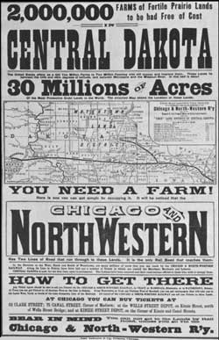
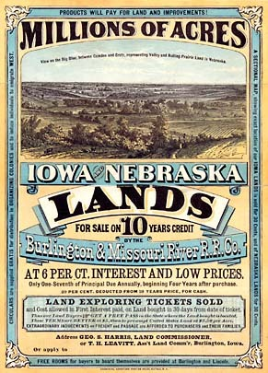

Slide 5
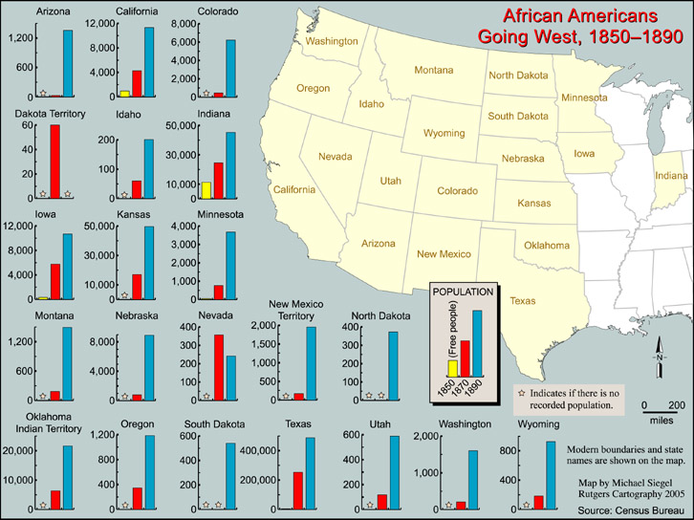

Slide 6
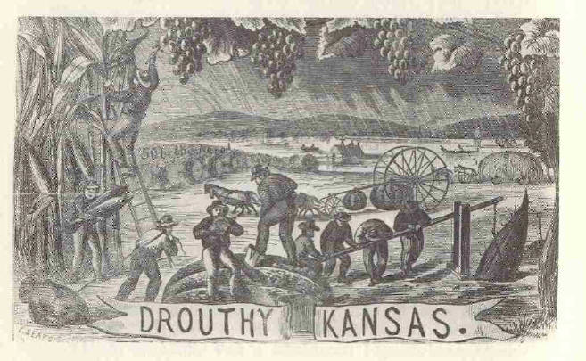
Nebraska promoter: “Rain follows the plow.”

Slide 7
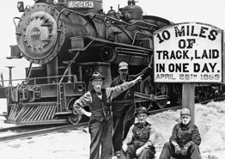
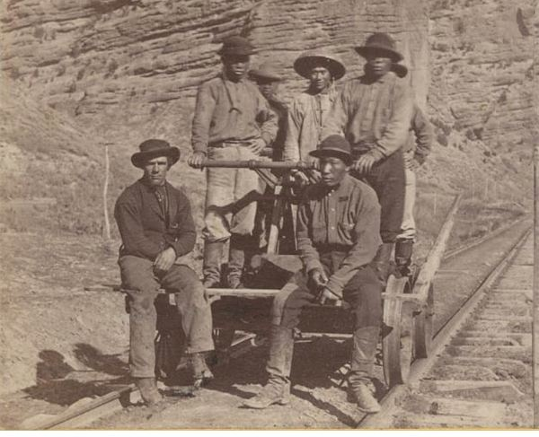

Slide 8
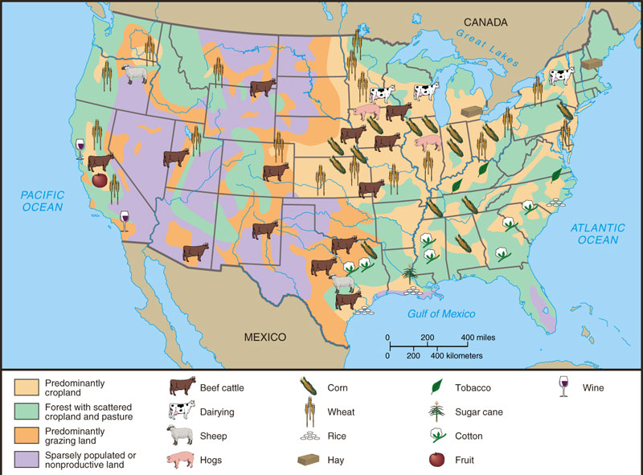
Land Use in 1880s

Slide 9
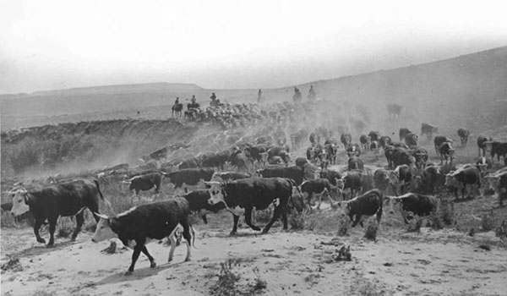

Slide 10
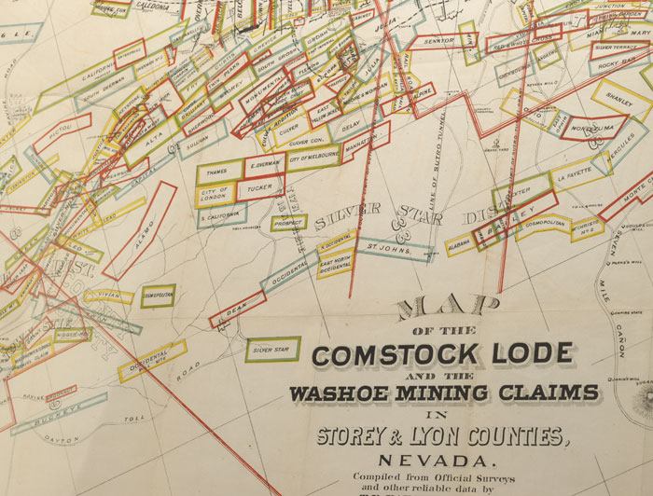

Slide 11
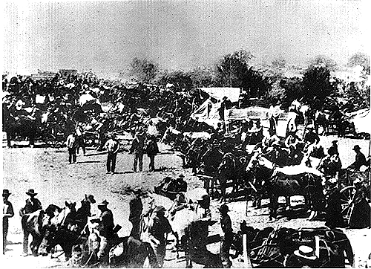
Moving West

Slide 12
WHY DO PEOPLE MOVE WEST?
1. Cheap land: used for farming and herding
2. Gold: 1848 Gold Rush
3. Railroad jobs
Justification: “Manifest Destiny”

Slide 13
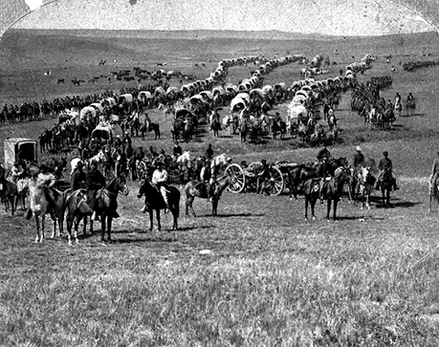
So, who moves…?
Notes:
make a chart on the board → reasons to move, so who fits these reasons?

Slide 14
1. Homesteaders- farmers
Moved from the Midwest where they had already been farmers
Lived in the Prairie states called America’s Breadbasket
Difficult conditions
Lived in soddies

Slide 15
A Hard Life on the Plains
Thick sod (a layer of soil tangled with roots) covered fertile soil
1877 – John Deere created a steel plow that could bust up the sod
Notes:
Sod = cut into bricks & used to make walls for houses

Slide 16
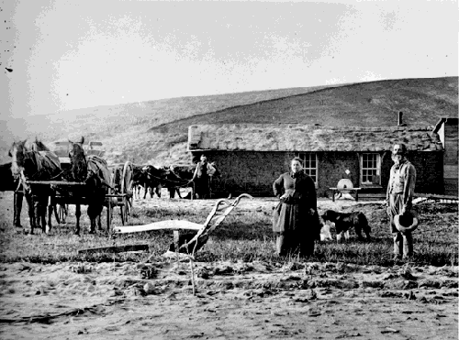

Slide 17
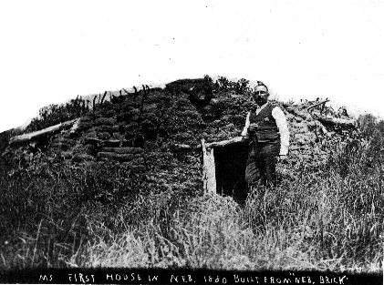

Slide 18
WHY?
Homestead Act 1862
government gave 160 acres of free land to any head of household who farmed it for 5 years

Slide 19
2. Exodusters
Former slaves who moved west to farm
70,000 African Americans
REVIEW
When did Civil War end?
After Civil War (during Reconstruction) what job did former slaves often have?
What was life like in the South during Reconstruction and afterwards for former slaves?
Notes:
1865
sharecroppers → don’t own land, VERY similar to slavery
rise of the KKK, rise of the Jim Crow South → lynching, segregation, unjust laws, etc.

Slide 20
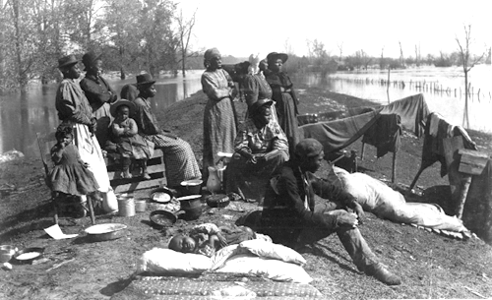

Slide 21
Last Rush for Land…
Oklahoma opened for settling!
April 1879 – 100,000 “boomers” lined up to wait for the signal to rush to claim their piece of land
Boomer Movement: white settlers who believed that all the Unassigned Land was open to anyone to settle, not just the Native Americans
1889: Some people snuck onto the land early and claimed the best plots of land (“sooners”)
Notes:
the whites believed that all the Unassigned Land was

Slide 22
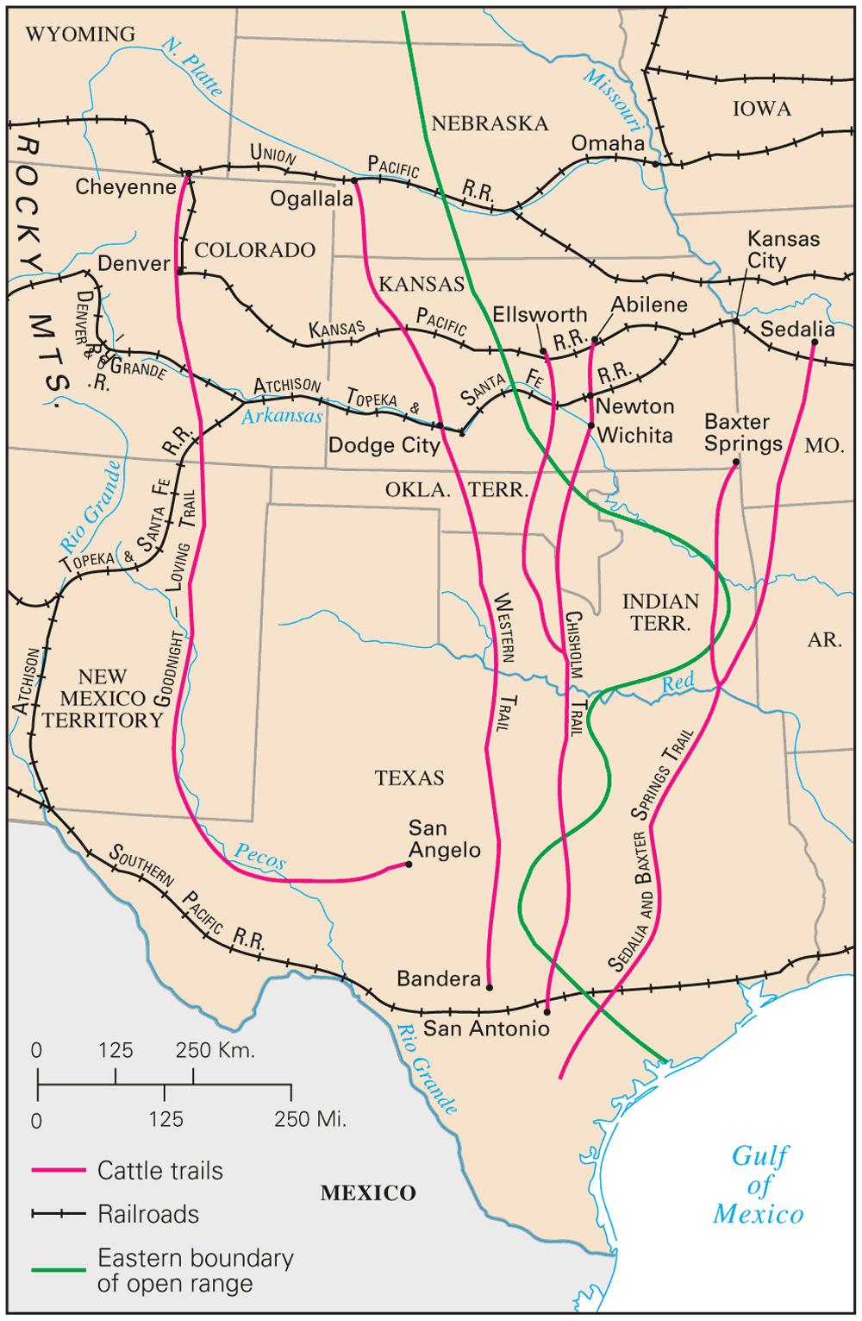
3. Cattle Ranchers and Cowboys
Demand of beef in east and RR
Most cattle had been raised on “open ranges”
“the long drive” → cow town is a city at the end of a cattle trail
barbed wire invented 1874
Notes:
Railroads allowed fresh meat to reach the east without spoiling
Cattle Drives – herded and moved your cattle from the open range up to the town with the railroad
2-3 months to make the trip

Slide 23
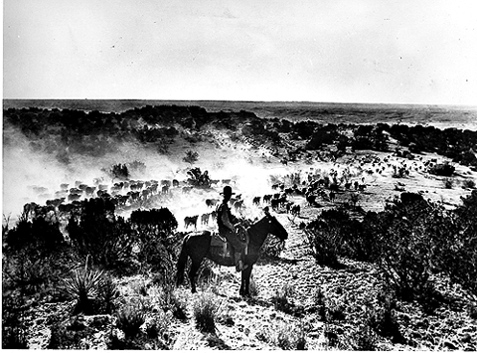

Slide 24
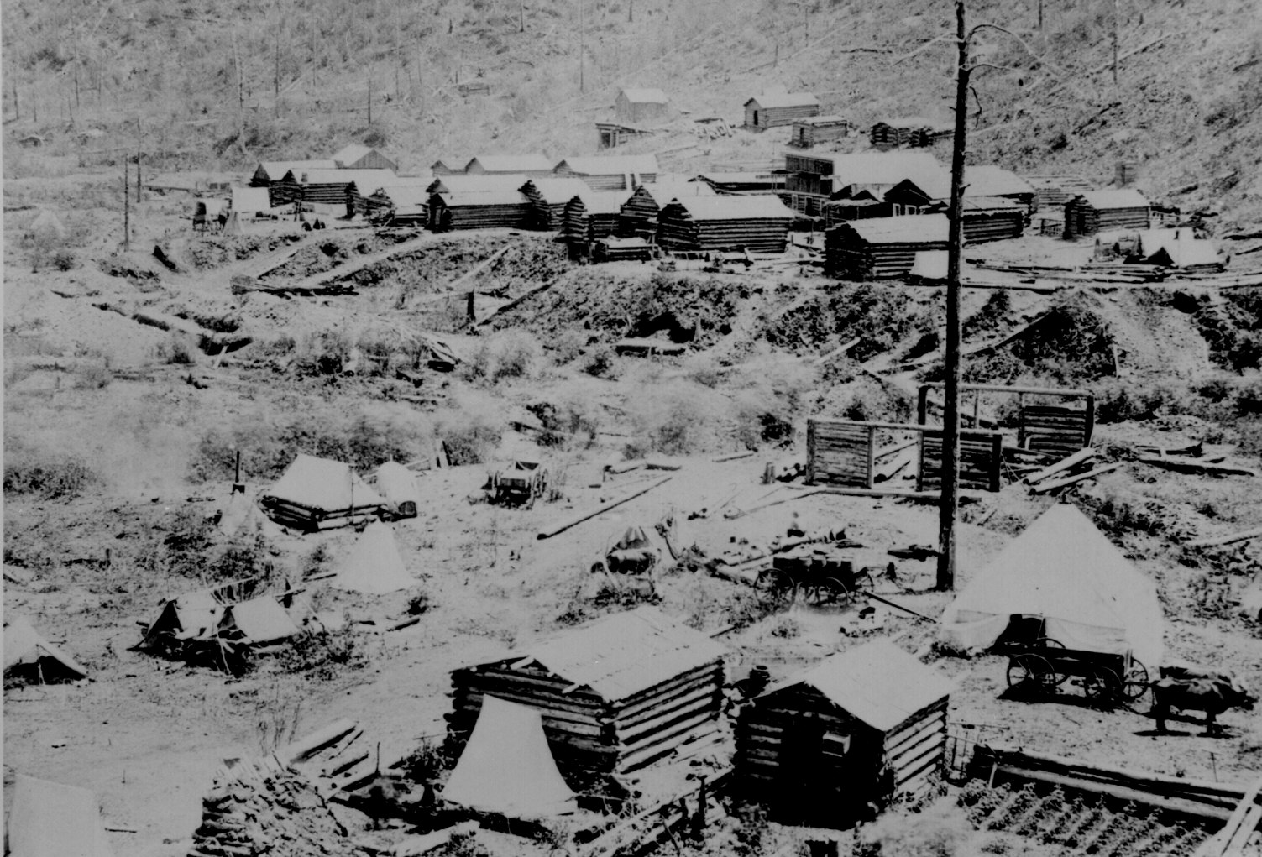
4. Miners
Comstock Lode 1859 – one of the largest gold & silver deposits discovered in Nevada
few find gold → most become farmers or move back east
boom towns,
vigilantes, ghost
towns
Notes:
boom towns → tent cities that popped up near mines that only lasted until the gold or silver was gone → vigilantes … → eventually ghost towns
Miners formed vigilante police forces to protect themselves
Boomtowns quickly turned to ghost towns
http://www.dailymail.co.uk/news/article-2140121/Black-white-images-rare-glimpse-life-American-frontier.html

Slide 25
5. Transcontinental Railroad (1862-1869)
RR that linked the country from coast to coast
Goal: make trade easier
Government gives RR companies land grants (free land) … in crisscross pattern
RR built by immigrants
Notes:
http://www.history.com/topics/inventions/transcontinental-railroad

Slide 26
Transcontinental Railroad
Central Pacific
Chinese immigrants
through Rocky Mts
Who builds the Railroads?
Union Pacific
Irish immigrants
Across the Great Plains

Slide 27
Transcontinental Railroad
Where do the Central Pacific and Union Pacific Railroads meet?
Promontory Point, Utah with a golden spike (May 10, 1869)

Slide 28
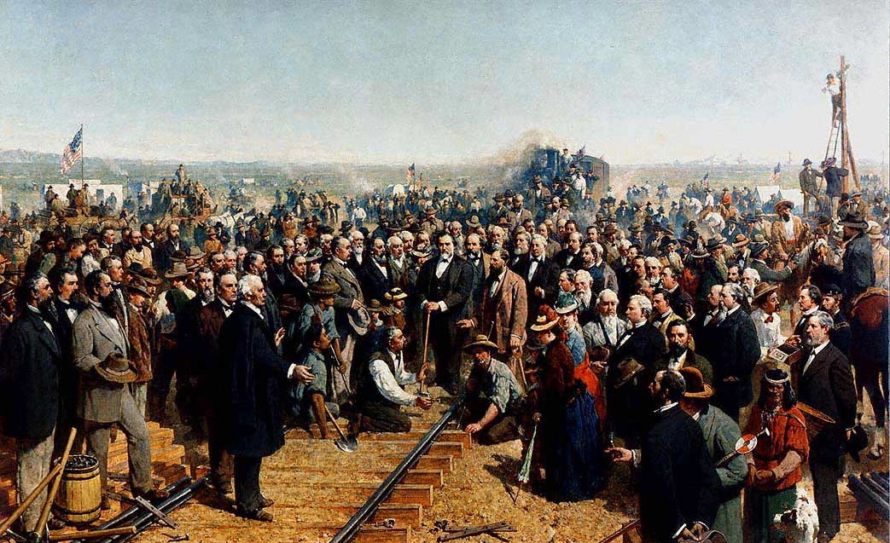
Notes:
“When they came to drive the last spike, Governor Stanford, president of the Central Pacific, took the sledge, and the first time he struck he missed the spike and hit the rail.
What a howl went up! Irish, Chinese, Mexicans, and everybody yelled with delight. 'He missed it. Yee.' The engineers blew the whistles and rang their bells. Then Stanford tried it again and tapped the spike and the telegraph operators had fixed their instruments so that the tap was reported in all the offices east and west, and set bells to tapping in hundreds of towns and cities... Then Vice President T. C. Durant of the Union Pacific took up the sledge and he missed the spike the first time. Then everybody slapped everybody else again and yelled, 'He missed it too, yow!’”
http://www.eyewitnesstohistory.com/goldenspike.htm

Slide 29
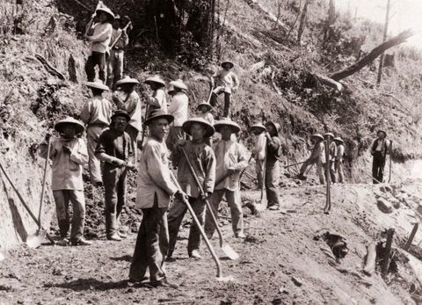
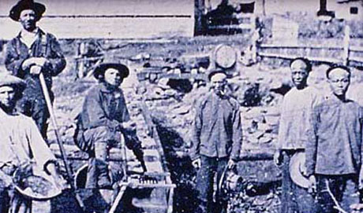
“Didn’t they build the Great Wall of China…?”
- Chinese paid $27, then $30/mo
- Irish paid $35/mo
(both minus cost of food and board)
Notes:
initially prejudice, but b/c of labor shortage could work; issues with Irishmen → the Chinese were punctual, willing, and well-behaved “model immigrant” not agitating over wages;
article with information: http://www.pbs.org/wgbh/americanexperience/features/general-article/tcrr-cprr/

Slide 30
Building the Transcontinental RR
Workers lived in canvas camps alongside the grade. In the mountains, wooden bunkhouses protected them from the drifting snow, although these were often compromised by the elements… Irish crews stuck to an unvarying menu of boiled food -- beef & potatoes -- the Chinese ate vegetables and seafood, and kept live pigs and chickens for weekend meals.
The newcomers seemed alien in other ways: they bathed themselves, washed their clothes, stayed away from whiskey. Instead of water they drank lukewarm tea, boiled in the mornings and dispensed to them throughout the day. In such a manner they avoided the dysentery that ravaged white crews.

