Slide 1
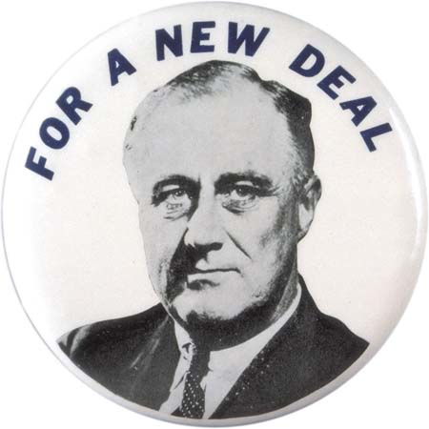
FDR – Franklin Delano Roosevelt
“Only thing we have to fear is fear itself”

Slide 2
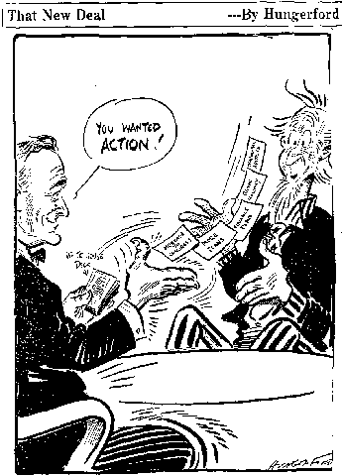
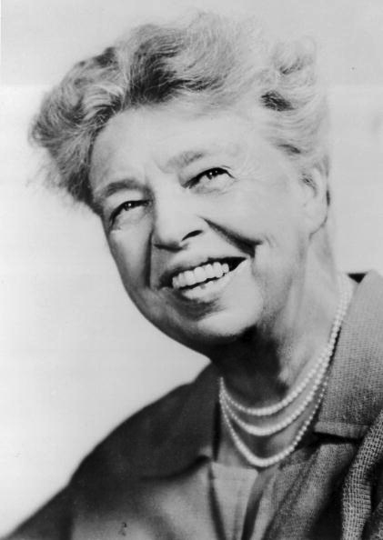
FDR
Brain Trust: FDR’s highly educated advisors
Eleanor Roosevelt: FDR’s wife and advisor.
As first lady she worked tirelessly to help minority
groups, often disagreeing with her husband’s
policies publicly.
Fireside chats: radio addresses given by FDR to the American public
First Hundred Days: FDR focused on immediate relief; Congress granted every request
intellectuals in gov’t
Notes:
“New Deal witnessed an increased role for intellectuals in government. The Brains Trust, a term coined by James Kieran, a New York Times reporter, refers to the group of academic advisers that FDR gathered to assist him during the 1932 presidential campaign. “
Eleanor Roosevelt quotes: “The function of democratic living is not to lower standards but to raise those that have been too low.”
Tomorrow Is Now (1963), 59
My greatest fear has always been that I would be afraid - afraid physically or mentally or morally and allow myself to be influenced by fear instead of by my honest convictions.
If You Ask Me (1946), 112

Slide 3
Role of the federal government:
ACTIVE! Hands ON!
Federal government’s job to fix depression
Who should American’s turn to for help?
The government!
This is a shift from who?

Slide 4
Approach to the Great Depression:
New Deal
Create agencies to foster relief, recovery and reform
Deficit Spending: The government will spend our way out of the depression (even though it means going into debt)
What was the overall impact of the New Deal?
The New Deal increased/enlarged the size of the federal government.
What was the philosophy of the New Deal?
The federal government should regulate and directly stimulate the economy by spending and hiring.

Slide 5
The First New Deal
Guiding Principals:
Relief
Recovery
Reform
Immediate action taken to halt the economy’s deterioration
*Programs to fix the economy ASAP
Temporary programs to restart the flow of consumer demand
Permanent programs to avoid another depression and insure citizens against economic disasters
Programs such as: FDIC, FHA, SEC, Social Security

Slide 6
New Deal Part 1
First Hundred Days
what agencies did he enact?
what problems did they solve?
what problems were left unsolved?
what are some criticisms that might come about?
What are YOUR criticisms?
Notes:
watch from 13 – 18
p740-741 (APUSH) = criticisms – conservatives said it went to far, liberals said it wasn’t doing enough!
Coughlin – FDR = “great betrayer and liar,” anti-Semitic allusions, called for nationalization of the bank; National Union of Social Justice; complained that FDR wasn’t doing enough to help the public. He wanted government to take over control of major industries and businesses.
Townsend – gov’t should pay $200/mo to retired citizens & retirees req’d to spend in 30 days … plan would’ve bankrupted the nation
Long – “Share our Wealth” program (100% tax on all incomes over $1 mil) → promised comfortable income, a car, free college education … wah wah, shot in Sept. 1935
Agricultural Adjustment Act; Bank holiday; Civilian Conservation Corps; Federal Emergency Relief Administration; Federal Deposit Insurance Corp.; National Labor Relations Board (Wagner Act); Securities and Exchange Commission; Social Security ; Tennessee Valley Authority; Works Progress Administration; National Recovery Administration (fair competition – production limits, prescribed wages, working conditions, etc.)
NLRB: guarantee employees “the right to self-organization, to form, join, or assist labor organizations, to bargain collectively through representatives of their own choosing, and to engage in concerted activities for the purpose of collective bargaining or other mutual aid and protection.”

Slide 7
Major Accomplishments
Banking and Finance: FDIC (Federal Deposit Insurance Corporation), SEC (Securities & Exchange Commission)
For Farmers: AAA (Agricultural Adjustment Act), TVA (Tennessee Valley Authority)
Works Projects: CCC (Civilian Conservation Corporation), PWA & CWA (Public & Civilian Works Administration)

Slide 8
Major Accomplishments
Fair Practices: NIRA (National Industrial Recovery Act)
Food and Clothing: FERA (Federal Emergency Relief Act), FHA (Federal Housing Administration), HOLC (Home Owner’s Loan Corporation)
Notes:
FEHRA – federal funds to state & local agencies to help the unemployed; HOLC = loand $$ at low interest to home-owners who could not meet mortgage rates; FHA insured bank loans used for building and repairing homes
NIRA = considered his “most important & far-reaching legislation every enacted by the American Congress” – developed codes for fair competition; min wage and min prices for goods

Slide 9
Problems in the Great Depression
Problems
New Deal Solutions
Notes:
add in problems – type them in
THEN WATCH Video,
list of agencies on the board … which solve which problems? → PRINT OFF
People didn’t trust the banks and many banks have failed.
The stock market crashed, in part because people were buying stocks on margin.
Farm prices were low, due to overproduction.
People needed money quickly in order to buy food and avoid home foreclosure.
People in rural areas need electricity and jobs.
Different industries need help recovering.
Everybody needs jobs!
The elderly or sick (people who can’t work) also need money to support themselves.
Minorities tend to be the “last hired and first fired”
Women must take care of families but are often left behind by their husbands and have a hard time finding jobs.

Slide 10
Critics of the First New Deal
Liberal (Democratic) Critics: think FDR is not doing enough
Senator Huey Long (Democrat-Louisiana)
Nicknamed “The Kingfish”
Wanted to redistribute wealth
assassinated
Conservative (Republican) Critics: think FDR is doing too much
Supreme Court
Notes:
+ Liberal = FDR’s only concern = banks & big business; ND does not address redistribution of wealth, ND does not help elderly
+ Conservative = gov’t is too powerful, increased role of gov’t = socialism (sound familiar?), ND destroys free enterprise and individual freedom, ND creates HUGE national debt

Slide 11
Supreme Court Steps In
Schechter v. US (1935)
Supreme Court declared the NIRA unconstitutional
US vs. Butler (1936)
Supreme Court declared the AAA unconstitutional

Slide 12
Supporters of the New Deal
New Deal Coalition: Diverse group of Americans who had one thing in common: they liked the New Deal
Suburban whites, people living in cities, unionized workers, African Americas, Mexican Americans…
For the first time in American history, African Americans shift their votes to the Democratic Party

Slide 13
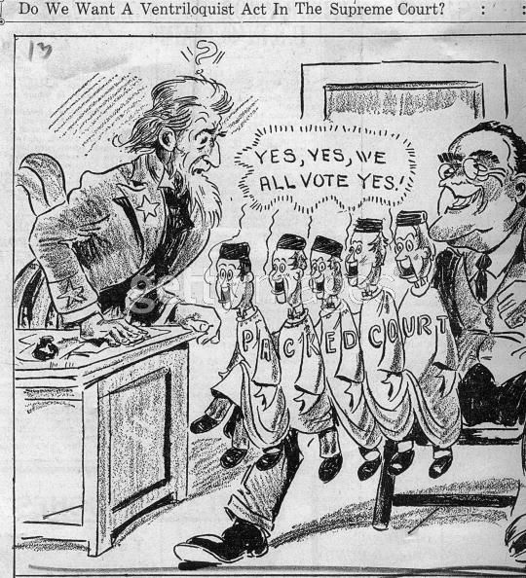
Court Packing
FDR wanted to add justices to court to get New Deal programs approved
Does NOT happen
FDR legally appoints 7 new justices

Slide 14
The Second New Deal
Goal: build upon 1st New Deal by
lower unemployment
raise production
extend relief
Method: “Make Work”
Create as many jobs as possible
When you make jobs, you pay the workers, they then buy stuff, this creates more jobs for people who sell things….

Slide 15
The Second New Deal
For Farmers: 2nd AAA (Agriculture Adjustment Act), RA / FSA (Resettlement Act → Farm Security Administration), REA (Rural Electrification Act)
Works Projects: WPA (Works Progress Administration)!
For workers: Fair Labor Standards Act, Wagner Act – aka: NLRB (National Labor Relations Act)
For kids: NYA (National Young Administration)
For the elderly: SSA (Social Security Act)
Notes:
Also have the Banking Act of 1935 (finalized FDIC and made insurance for bank deposits permanent); US Housing Authority (subsidized construction of low-cost public housing w/ fed’l loans); WPA = highways, bridges, etc. to build up infrastructure as well as provide jobs; NYA trained youth and provided counseling for unemployed btw 16 & 25; Fair Labor Standards Act banned child labor, min’ hourly wage est’d, and set work week to 44 hrs; Food Drug & Cosmetic Act (prohibited mislabeling of food, drugs, cosmetics to ensure safety)

Slide 16
Compare & Contrast: Hoover vs. FDR
Notes:
political policies
personal outlook on GD
view on role of gov’t
public opinion … why?
turning points in career (thus far for FDR)
comfort with media → fireside chats, etc.

Slide 17
Legacies of the New Deal
FDIC – banking insurance critical to sound economy
SEC – “watch-dog” of stock market
NLRA & FLSA – supervise labor relations, minimum wage, etc.
Deficit spending has became a normal feature of government
Social Security is a key legacy of the New Deal in that the Feds have assumed a greater responsibility for the social welfare of citizens since 1935
Notes:
Look to pg 624 → cause & effect chart of New Deal / Depression

